Slide 1

Pembelajaran Mesin
Machine Learning (ML)

Slide 2
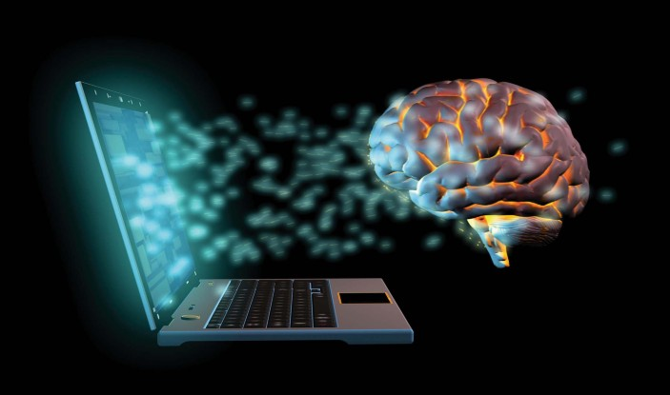
Artificial Intelligence?
“The science and engineering of making intelligent machines, especially intelligent computer programs”. (John McCarthy)

Slide 3
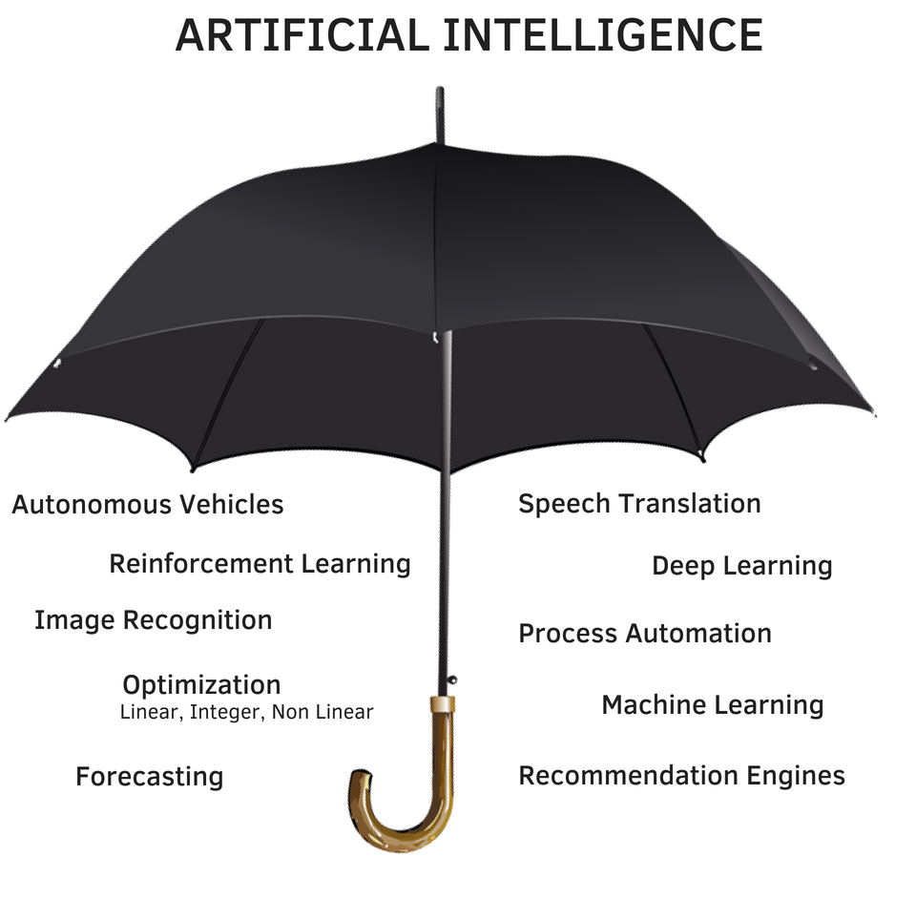

Slide 4
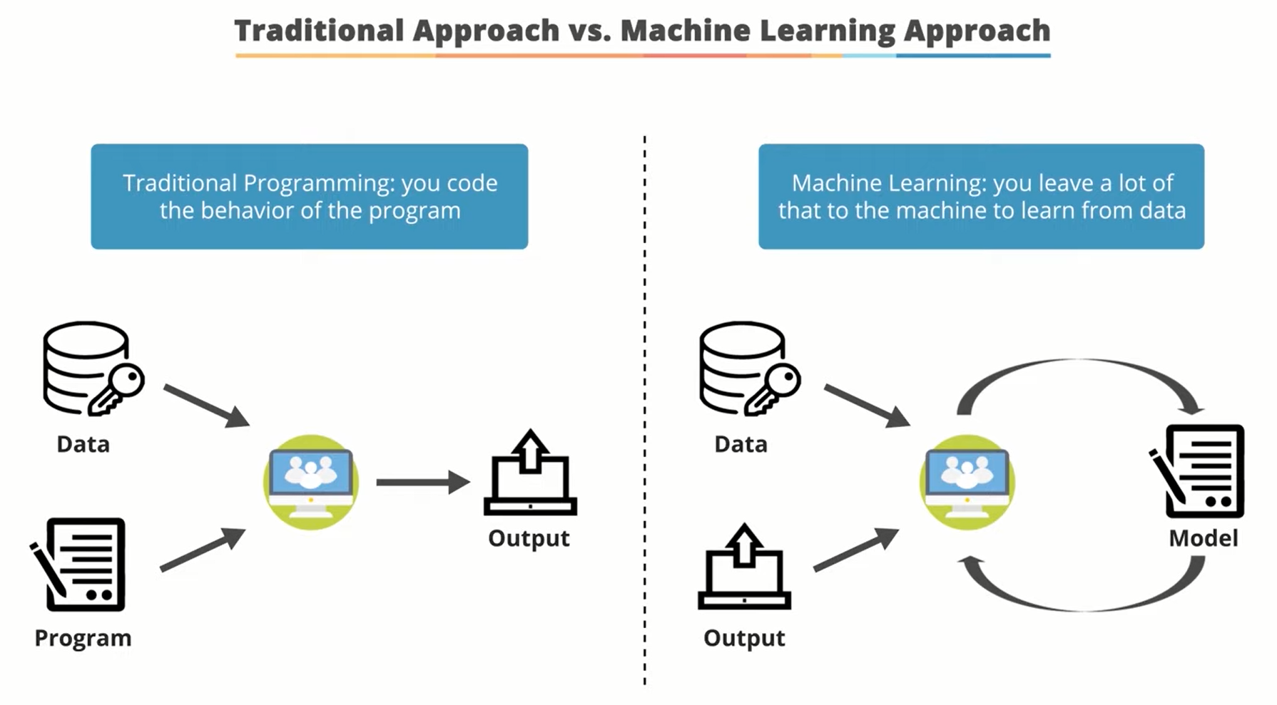
AI in a nutshell

Slide 5
GENERAL FLOW
input
fungsi
output

Slide 6
Traditional Approach
data
x | y
1 | 2
2 | 4
3 | 6
4 | 8
5 | 10
6 | 12
7 | 14
8
f(x) = 2x
16
y = 2x
Mudah melihat fungsinya (rule)!

Slide 7
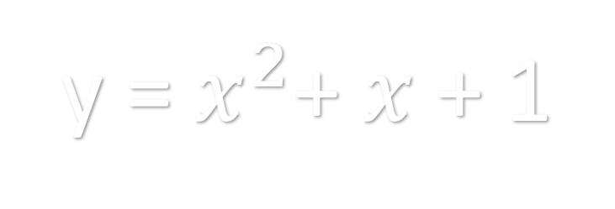
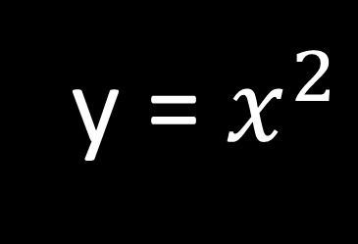
Coba Tebak Fungsi/Rule-nya…!
x | y
1 | 1
2 | 4
3 | 9
4 | 16
5 | 25
6 | 36
7 | 49
x | y
1 | 3
2 | 7
3 | 13
4 | 21
5 | 31
6 | 43
7 | 57
y = $x^{2}$
y = $x^{2}$+ $x$+ 1

Slide 8



Machine Learning Approach
Berikan aku f(x)!
MODEL
f(x)
Aku akan melatih komputer

Slide 9
GOAL?
Aku sudah terlatih dan pintar!
Jadi, apa yang bisa kubantu?

Slide 10
Ya, aku bisa memprediksi “sesuatu”
Dari data di masa depan yang belum pernah kulihat
Perlu diingat !
Prediksiku hanya estimasi, bisa saja salah ☺

Slide 11
Machine Learning Definition
“Machine learning is a branch of artificial intelligence that enables computers to learn from data and improve their performance over time without being explicitly programmed.“ (Arthur Samuel)

Slide 12
Workflow
Training
ML
Algorithm
+
Learning
Training
Data
Model
Testing
Testing
Data
Model
Output

Slide 13
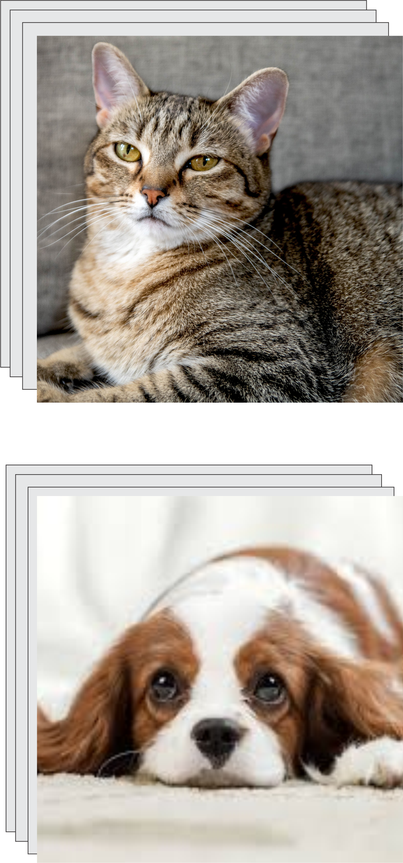

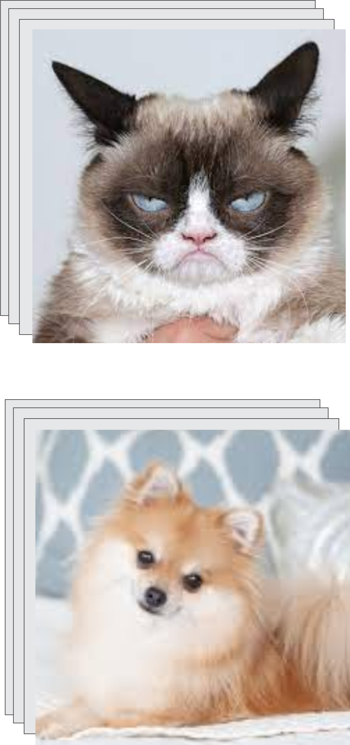
Workflow (cont’d)
Training
Neural Network
+
Learning
Testing
Output

Slide 14
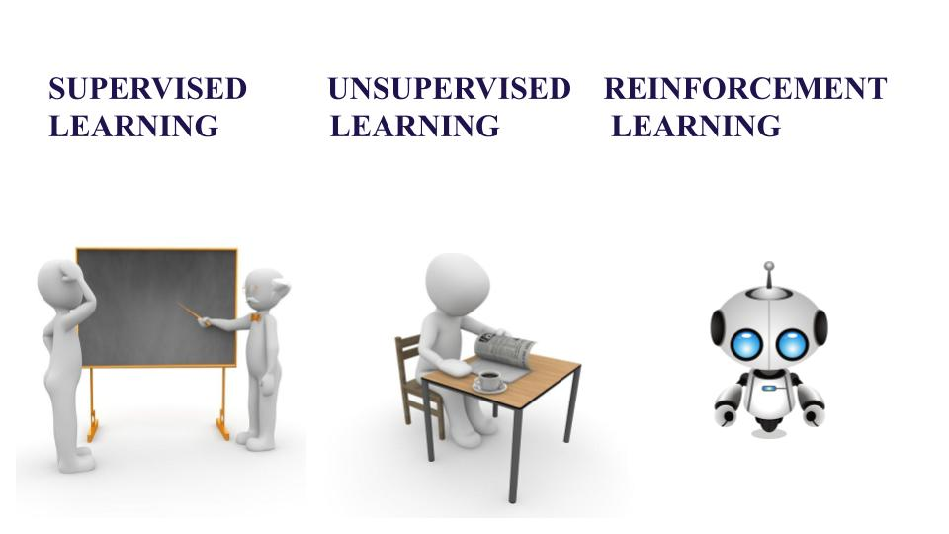
Jenis-jenis learning
Supervised Learning
Unsupervised Learning
Reinforcement Learning
Model dilatih dengan data yang diberi label sesuai keluaran yang sebenarnya.
Model dilatih dengan data yang tidak terlabel. Model diharapkan mencari pola tersembunyi.
Model dilatih pada lingkungan tertentu dengan trial and error. Biasanya dengan proses reward and punishment.

Slide 15



Intuition Behind Learning
Parameters
Internal variables or settings of a model that determine its behavior and ability to make predictions. Parameters are learned or adjusted during the training phase of the model.
Loss function
Also known as cost function or objective function, is a mathematical function that measures the difference between the predicted output of a machine learning model and the actual output.
Optimization
Process of finding the best set of parameters or weights for a model that minimizes a given loss function.
Training data:
$${\{(x_{i},y_{i})\}}_{i=1}^{n}$$
$$f\left(x\right)=ax+b$$
Temukan $a$ dan $b$ terbaik, sehingga $f\left(x_{i}\right)≈ y_{i}$

Slide 16

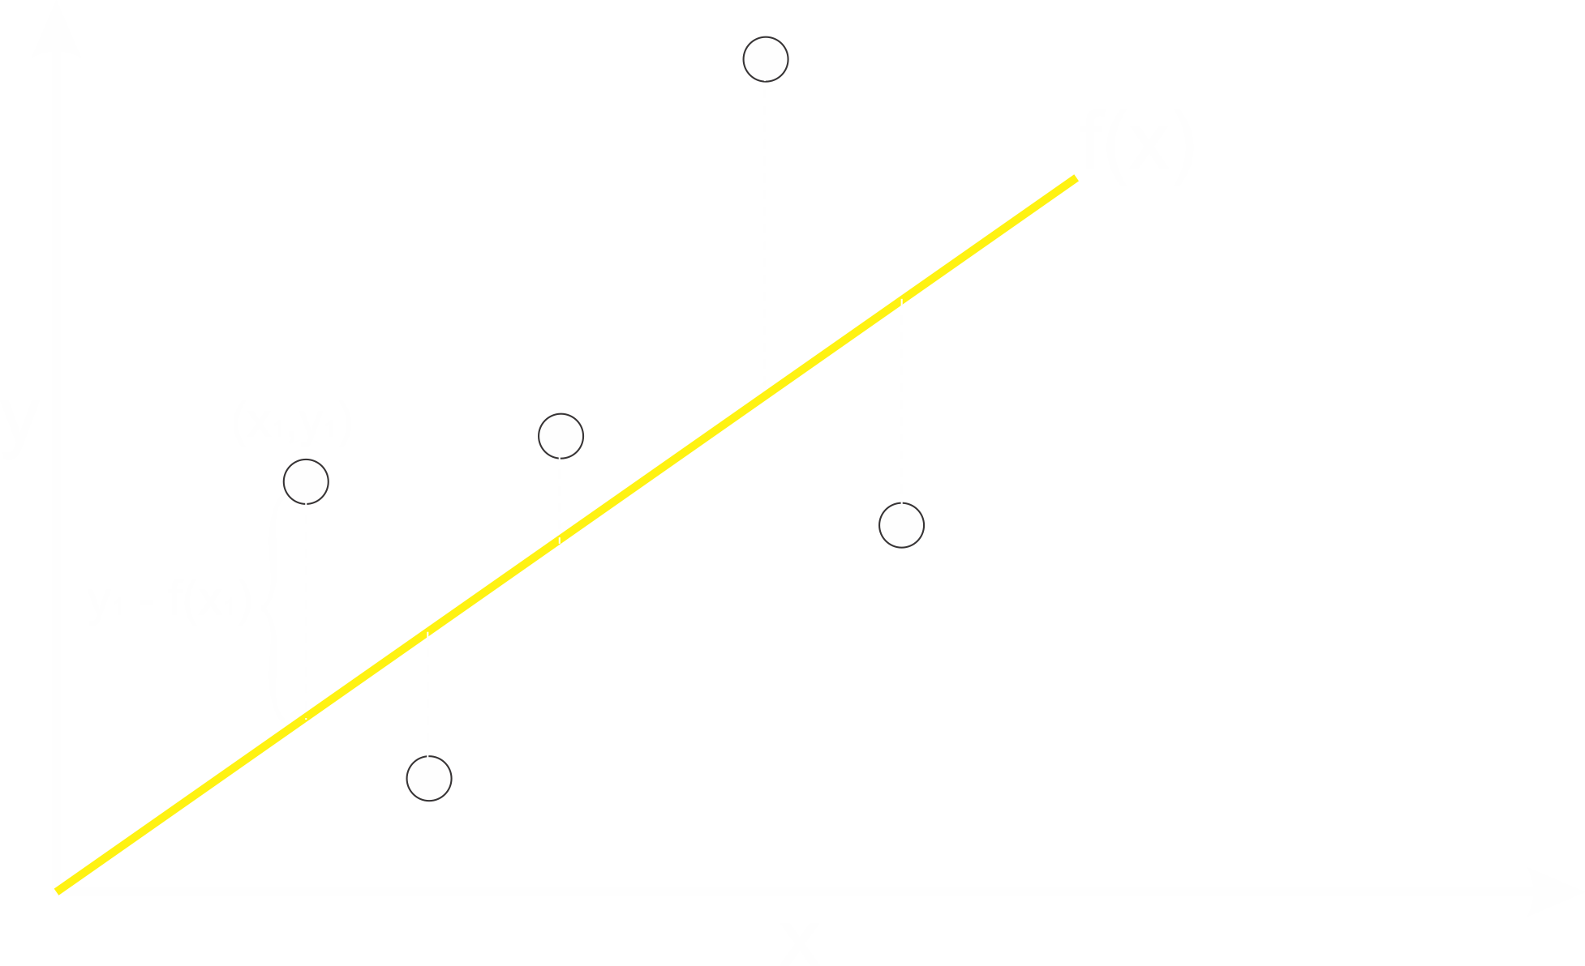


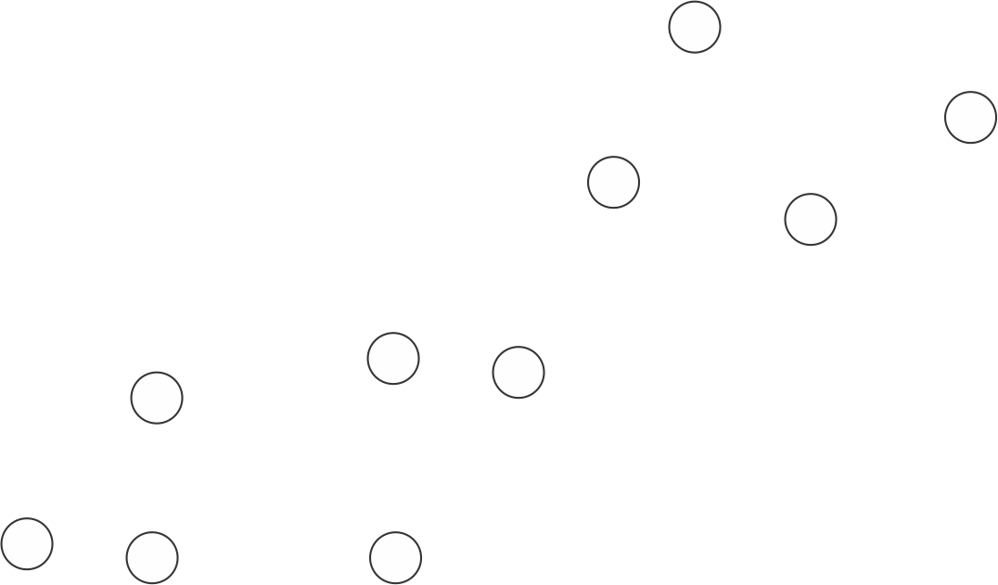

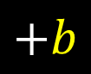




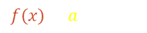
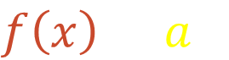

Let’s play..
1. Pilih sebuah Loss Function:
$L\left(a\right)= \frac{1}{n} \sum_{i}{{(y_{i} −f(x_{i}))}^{2}}$
Training data:
$${\{(x_{i},y_{i})\}}_{i=1}^{n}$$
$$MSE (Mean Squared Error)$$
$$L\left(a\right)= \frac{1}{n} \sum_{i}{{(y_{i} −ax_{i})}^{2}}$$
$$f\left(x\right)=ax$$
$$+b$$
Temukan $a$ terbaik, sehingga $f\left(x_{i}\right)≈ y_{i}$
$$f\left(x\right)=ax$$

Slide 17








Let’s play.. (cont’d)
2. Tentukan tujuan (objective)
$$minimize L\left(a\right)$$
1. Pilih sebuah Loss Function:
$$MSE (Mean Squared Error)$$
Find minimum $L\left(a\right)$
$$L\left(a\right)= \frac{1}{n} \sum_{i}{{(y_{i} −ax_{i})}^{2}}$$
$$f\left(x\right)=ax$$
$$L$$
$$a$$

Slide 18








Let’s play.. (cont’d)
2. Tentukan tujuan (objective)
3. Buat aturan untuk update nilai $a$
$$minimize L\left(a\right)$$
$$a_{baru}←a_{lama}−\text{η}\frac{ⅆL(a)}{ⅆa}$$
$$\text{η}\text{ = }\text{learning} \text{rate}$$
$$L$$
3. Berhenti jika telah mencapai convergence
$\frac{ⅆL(a)}{ⅆa}≈0$
$$f\left(x\right)=a_{baru}x$$
$$a$$
We have a new model!!

Slide 19





Summary
We have dataset
We have a model
$${\{(x_{i},y_{i})\}}_{i=1}^{n}$$
$$f\left(x\right)=ax$$
Calculate the loss
$$L\left(a\right)= \frac{1}{n} \sum_{i}{{(y_{i} −ax_{i})}^{2}}$$
No
Stop(?)
Yes
Update parameter(s)
(optimization/minimization)
$$f\left(x\right)=a_{baru}x$$
$$a_{baru}←a_{lama}−\text{η}\frac{ⅆL(a)}{ⅆa}$$

Slide 20
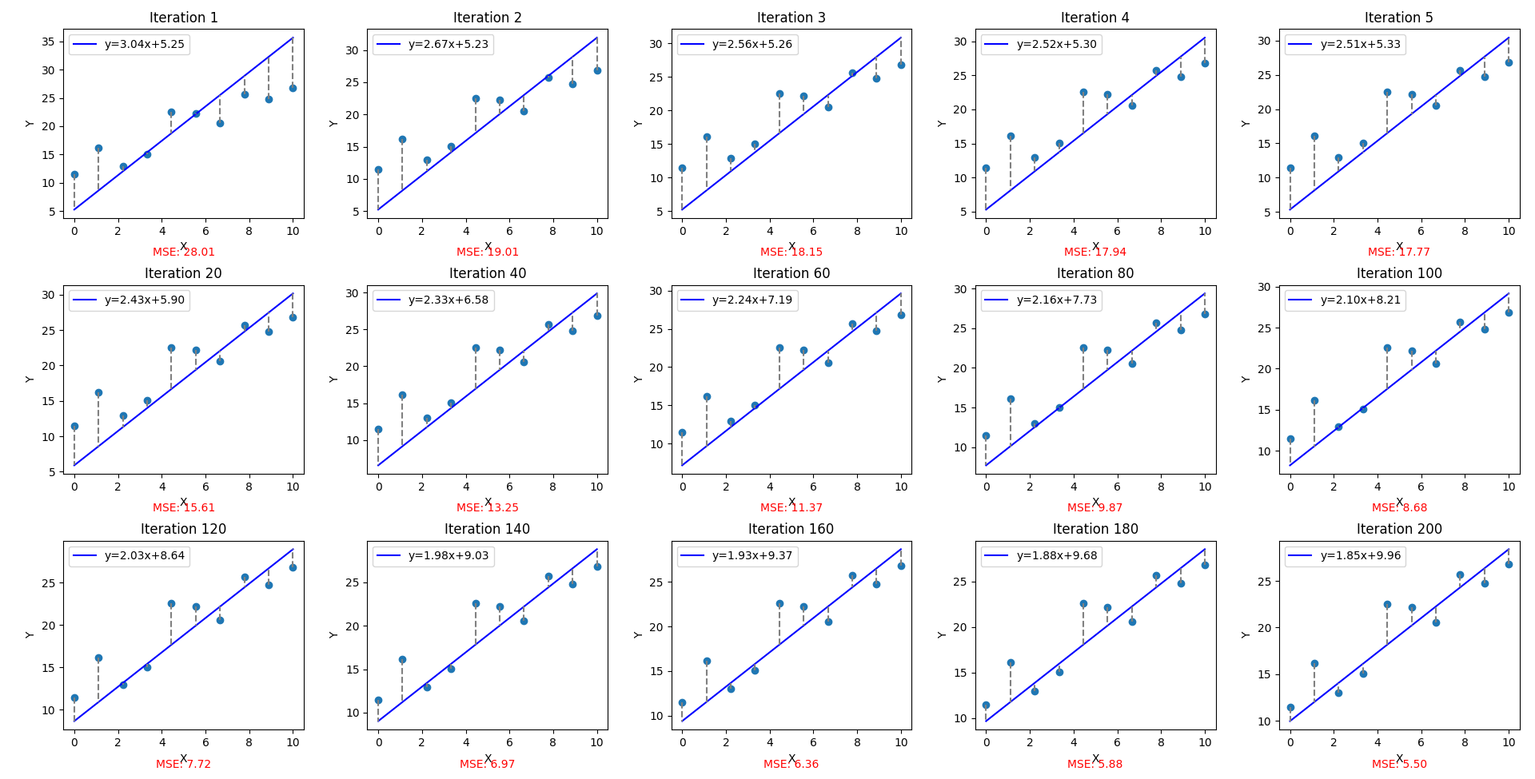

Slide 21
What we’ve learned..
Definisi AI ML
Intuisi learning dalam ML
How to train ML (Parameters, Loss Function, Optimization)

Slide 22
Next lecture…
Kapan kita menggunakan ML
Membahas tugas-tugas dalam ML
Membahas algoritma-algoritma dalam ML
Cara menentukan metrik-metrik evaluasi performa ML

Slide 23
Question?

Slide 24
Thank You

